Slide 1
Buffer Solutions
Dr. Muhammed Shah Miran
Professor, Department of Chemistry
University of Dhaka, Dhaka 1000

Slide 2
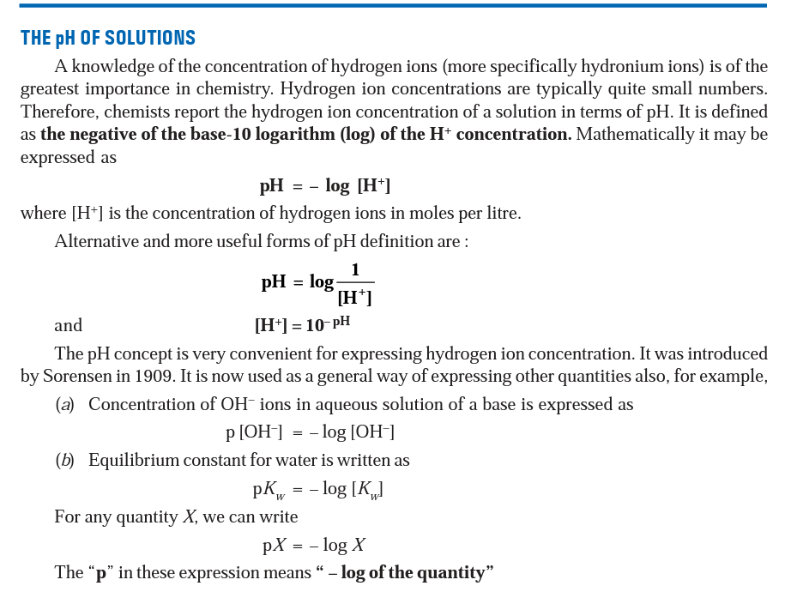

Slide 4
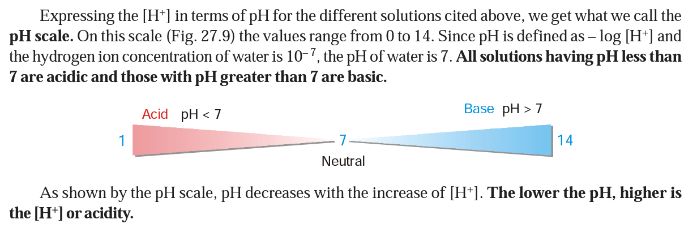

Slide 5
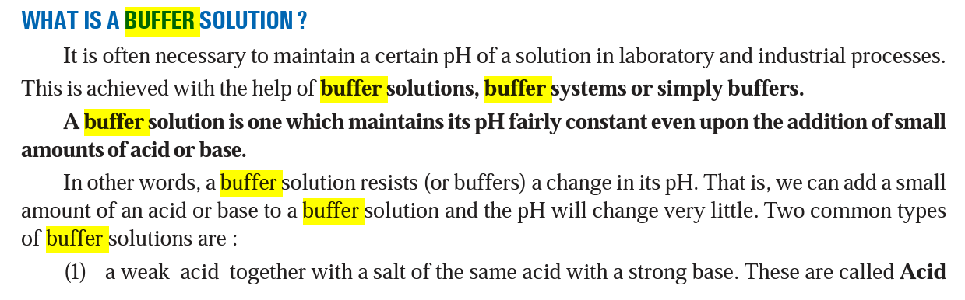


Slide 6
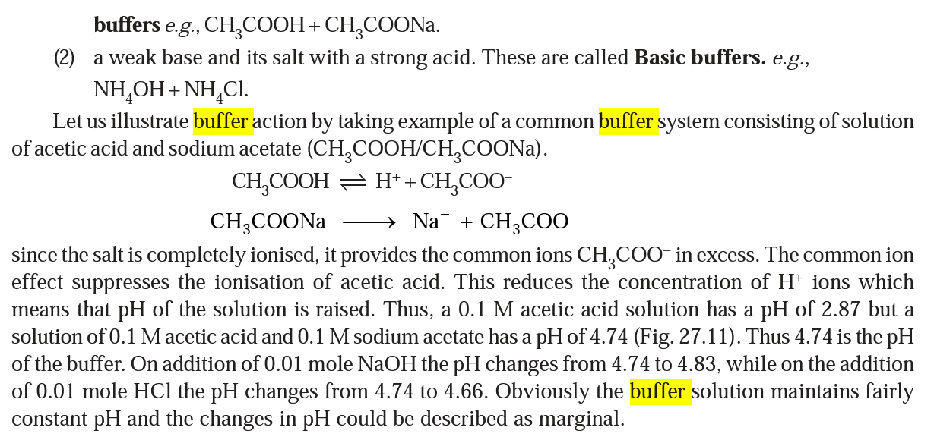

Slide 7
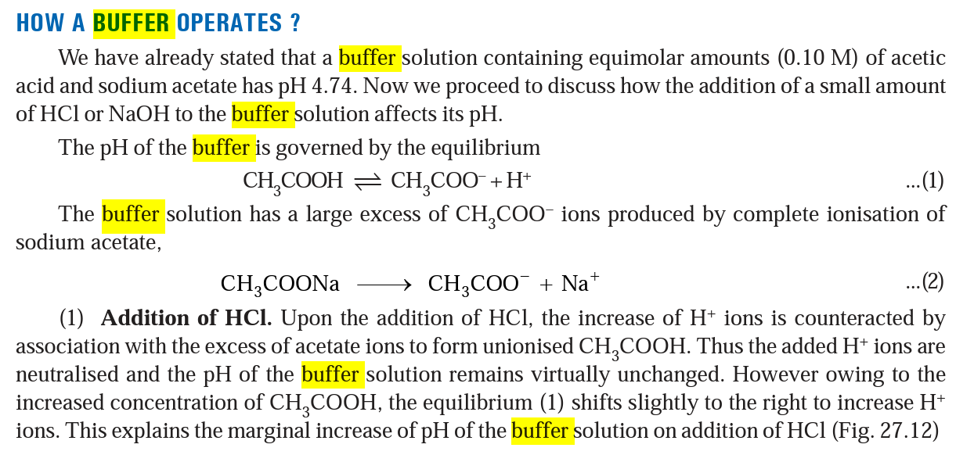


Slide 8
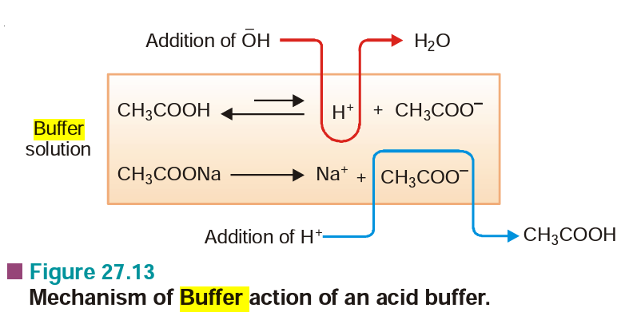

Slide 9
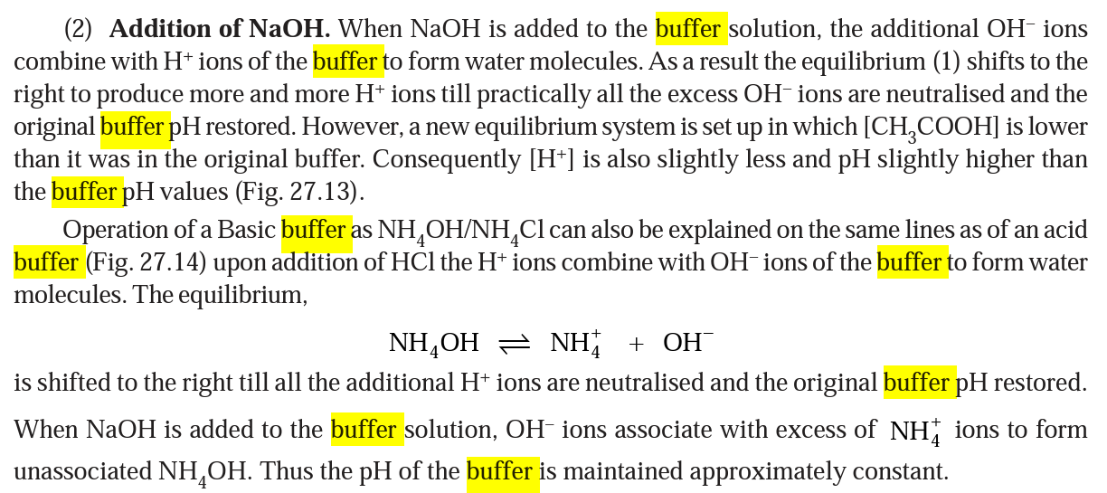

Slide 10
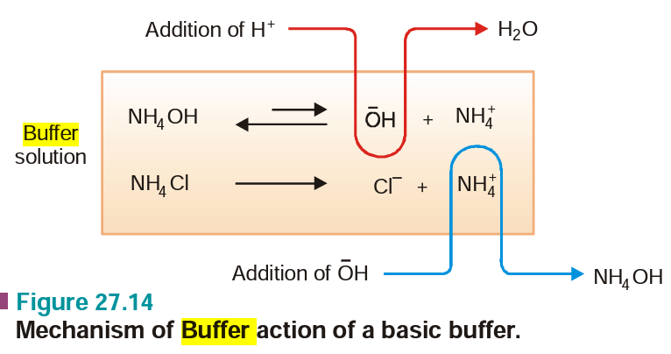

Slide 11
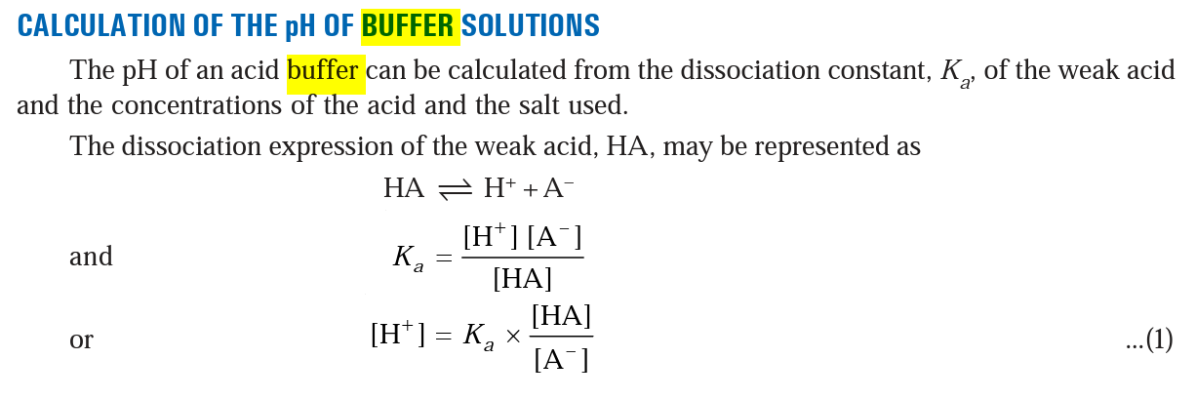

Slide 12
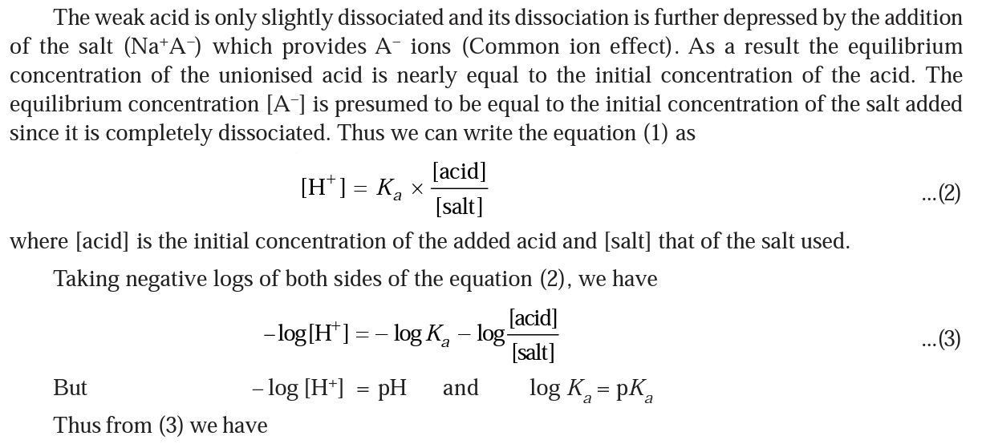

Slide 13
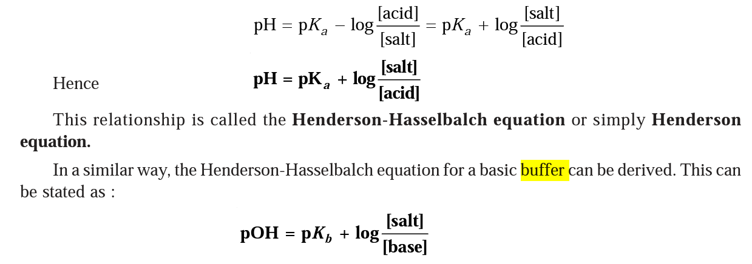

Slide 14
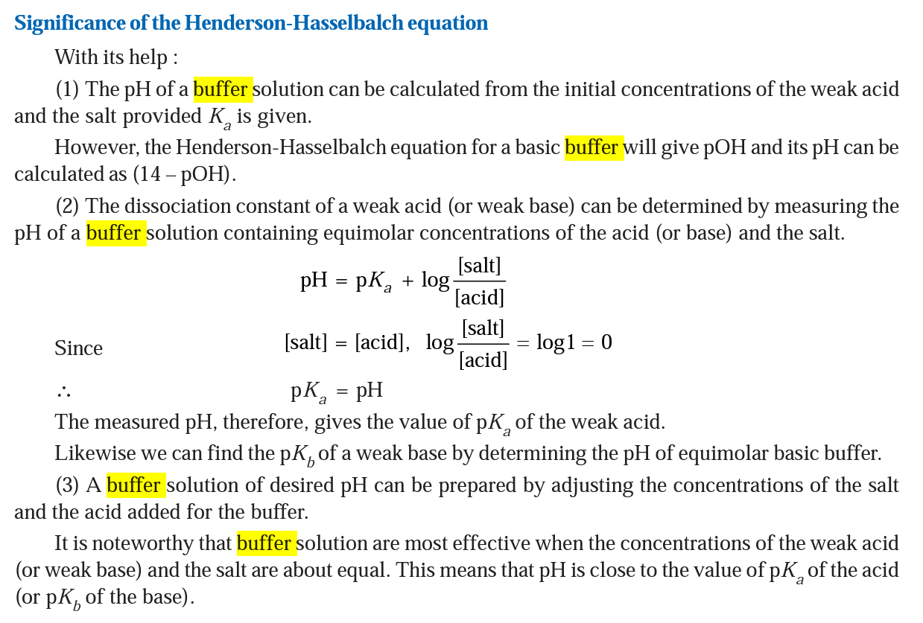

Slide 15
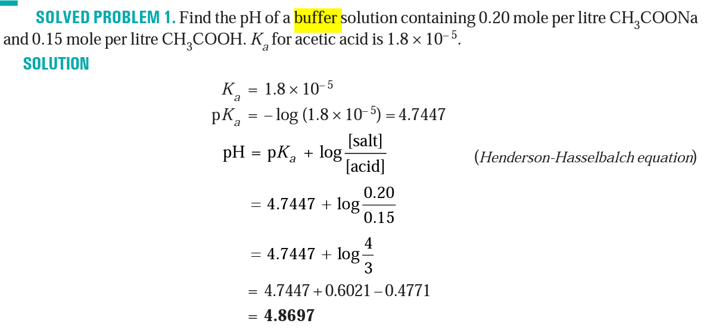

Slide 16
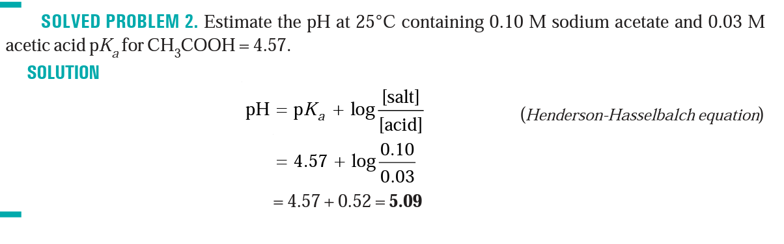

Slide 17
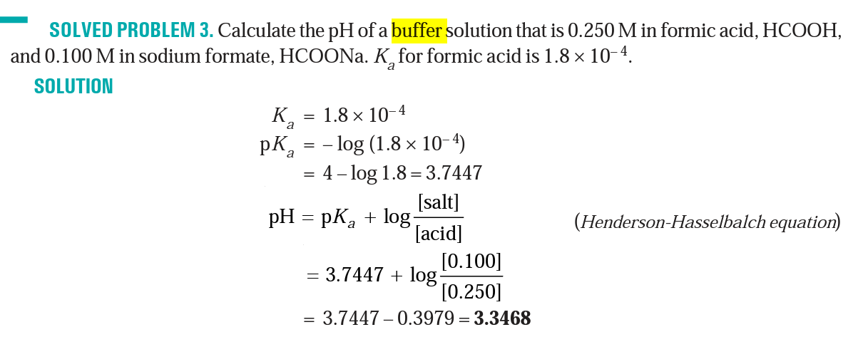

Slide 18
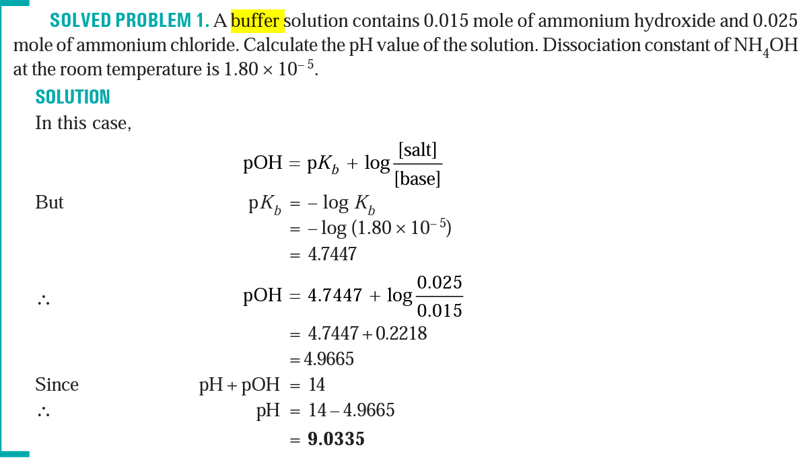

Slide 19
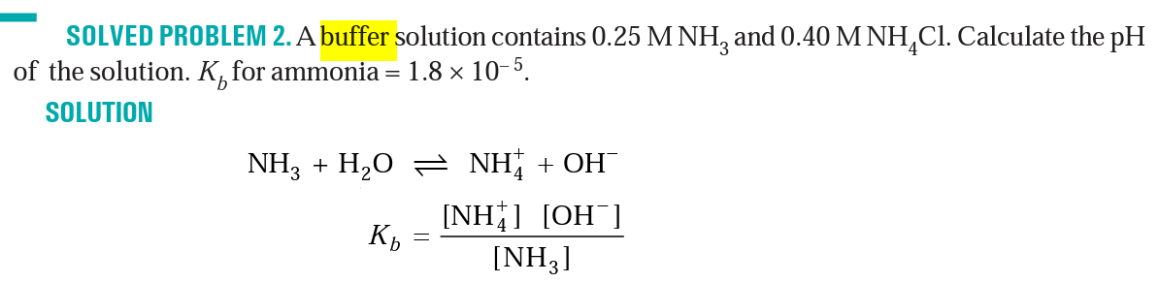
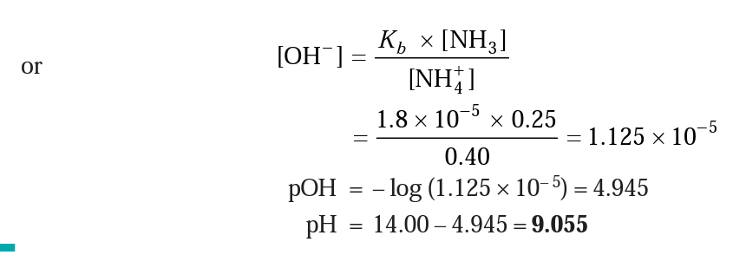

Slide 20
What are buffer solutions? Derive Henderson’s equation to calculate the pH of an acidic buffer and basic buffer solution.
Explain with an example why pH of a buffer solution does not change significantly on small additions of acids or bases.
Find the pH of a buffer solution containing 0.20 mole per litre CH₃COONa and 0.15 mole per litre CH₃COOH. Ka for acetic acid is 1.8 × 10– ⁵.
Estimate the pH at 25°C containing 0.10 M sodium acetate and 0.03 M acetic acid pKa for CH₃COOH = 4.57.
Calculate the pH of a buffer solution that is 0.250 M in formic acid, HCOOH, and 0.100 M in sodium formate, HCOONa. Ka for formic acid is 1.8 × 10^{– 4}.
A buffer solution contains 0.015 mole of ammonium hydroxide and 0.025 mole of ammonium chloride. Calculate the pH value of the solution. Dissociation constant of NH₄OH at the room temperature is 1.80 × 10^{– 5}.
A buffer solution contains 0.25 M NH₃ and 0.40 M NH₄Cl. Calculate the pH of the solution. K_{b} for ammonia = 1.8 × 10– ⁵.

